Slide 1





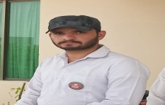
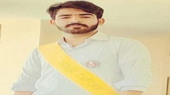



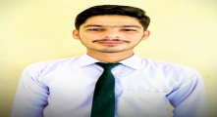



FC PUBLIC SCHOOL & COLLEGE,
Sui - Balochistan
Name: Saif Din
F. Name: Khan Bux
Class: X
Marks obtained: 1100/994
Percentage: 90.3%
Federal board of intermediate education Islamabad

